Slide 2
Introduction To Blackrock
BlackRock, founded in 1988, is the world’s largest Asset Manager and a premier provider of Risk management and advisory services to institutional, intermediary, and individual clients worldwide.
To a broad base of clients with portfolios totalling approximately US$13 trillion
BlackRock is a truly global firm that combines the benefits of worldwide reach with local service and relationships. They manage assets for clients in North and South America, Europe, Asia, Australia, the Middle East and Africa.
Mission and Principles
Our mission is to create a better financial future for our clients. As we pursue that mission, we’re guided by our culture and a set of principles that ensure we never forget what we stand for.
We are fiduciary to our Clients.
We are passionate about Performance.
We are One BlackRock
We are Innovators.

Slide 3
Asset Liability Administrative Debt and Derivative Institutional Network
Aladdin® is an operating system for investment managers that connects the information, people and technology needed to manage money in real time.
The Aladdin platform combines sophisticated risk analytics with comprehensive portfolio management, trading and operations tools on a single platform to power informed decision-making, effective risk management, efficient trading and operational scale.
More than just technology, Aladdin powers Collective Intelligence by providing tools to help organization communicate effectively, address problems quickly, and make informed decisions at every step of the investment process.

Slide 4
QTP
provides functional and regression test automation for software applications and environments.
It uses the Visual Basic Scripting Edition (VBScript) scripting language to specify a test procedure, and to manipulate the objects and controls of the application under test.
It works by identifying the objects in the application user interface or a web page and performing desired operations
ALM
ALM- test Management Tool by HP.
Application where the test scripts and test resources (Libraries and ORs, excel etc.) are stored.
Batch execution of automated scripts.
Creation of manual test cases and Capturing defects.

Slide 5
What is DR Checkout?
Blackrock Clients
Needham
East Wenatchee
Delaware

Slide 6
Objectives
Handover to Solution Center
Document for Handover
Automatic Log In To VM through Remote Desktop
• Issue with Blackrock Policy Screen
Log In to VM through VNC Viewer
• On going
Refactoring of “ADAM”(New Cash Scenario) Script
Successfully running with UI Changes
Exposure to few major ALADDIN Applications
ADAM ,PFM ,PFC ,Compliance ,Dashboard ,Trade-Entry

Slide 7
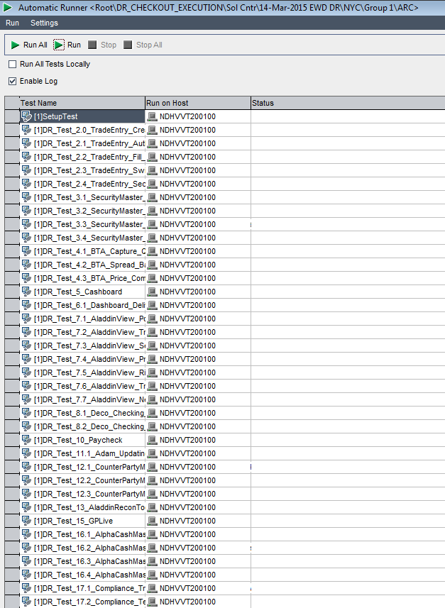
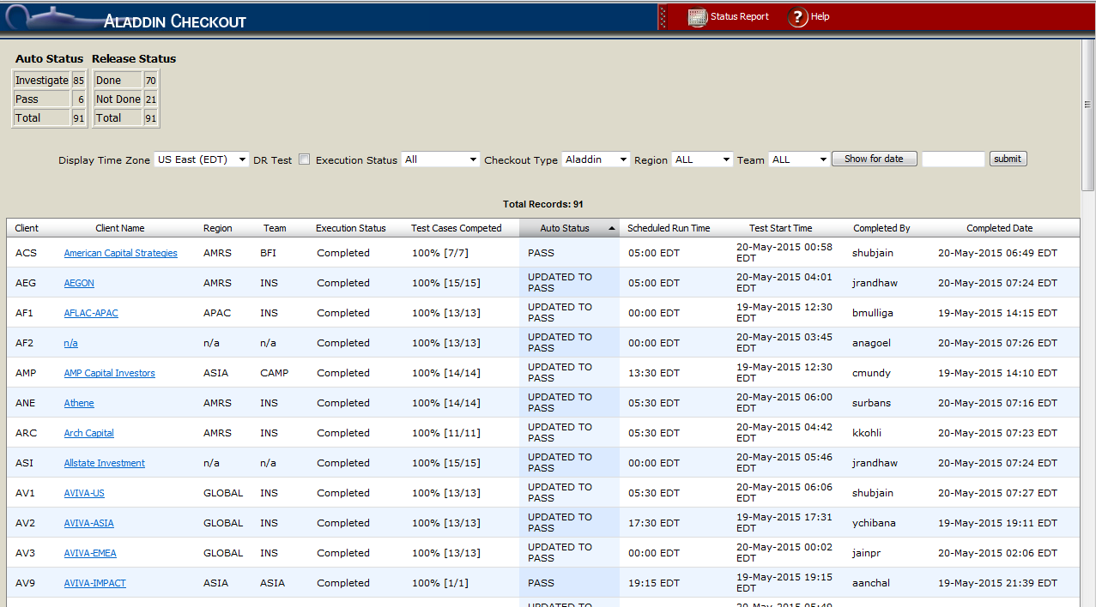
DR Execution (14-Mar-2015)
https://webster.bfm.com/weblications/dcreports/index.epl
Reporting website
Morning Checkout and Automated DR Book triggered from ALM

Slide 8
DR Execution (14-Mar-2015) Contd..
Statistics:
Asia Clients
New York Clients
Client | Total Tests | Passed | Failed | Out of Scope | Success Rate
AFL | 47 | 37 | 7 | 3 | 84%
MIZ | 47 | 37 | 7 | 3 | 84%
SMI | 47 | 38 | 6 | 3 | 86%
AVI | 46 | 37 | 6 | 3 | 86%
CFS | 47 | 38 | 6 | 3 | 86%
IIM | 47 | 34 | 10 | 3 | 77%
PNR | 47 | 39 | 5 | 3 | 89%
Client | Total Tests | Passed | Failed | Out of Scope | Success Rate
ARC | 45 | 35 | 7 | 3 | 83%
BBN | 44 | 34 | 7 | 3 | 83%
MSI | 47 | 35 | 9 | 3 | 80%
SCH | 42 | 34 | 7 | 1 | 83%
BSP | 43 | 40 | 2 | 1 | 95%
GEM | 46 | 41 | 2 | 3 | 95%
MET | 47 | 37 | 7 | 3 | 84%
SLF | 48 | 42 | 3 | 3 | 93%
SRE | 47 | 39 | 5 | 3 | 89%
ASI | 47 | 41 | 3 | 3 | 93%
CAT | 44 | 32 | 9 | 3 | 78%
WCH | 33 | 29 | 3 | 1 | 91%

Slide 9
Future State
The time for execution can be reduced if we have more number of VM’s for parallel execution of scripts.
Memory Expansion for VM’s : More stable execution
Complete handover to Solution Center

Slide 10
What did we learn?
Technical learnings
Quick Test Professional Tool :
Application Life Cycle Management Tool :
VB Script
Learning about processes
Testing Process
Disaster Recovery
Learning about working in team
Learnt about the expertise of different individuals and collaborating with them and asking questions about the area they work in.
Taking their help and ideas in developing our project.

Slide 11
Technical learnings
Creation of QTP scripts.
Debugging the Scripts. (f5,f10,f11)
Working and understanding various applications that promote trading activity.
Working with the test scripts and functional libraries.
Running the tests manually and by automation.
Learning about processes
Software Testing Lifecycle
Automation processes.
Learning about working in a team
Working closely with the functional team as well as the AST team.
Working together has proved to be an important aspect in working efficiently.
Learning about domain
Various financial terms like stocks, bonds, derivatives, primary market, secondary market etc.
Learnt how the flow of money goes through in BlackRock from client onboarding till client reporting
Learning about etiquettes
Business etiquettes respect seniors
How to write emails to peers and senior management

Slide 12
Thank you!

